Slide 1
Forensic Science: The Case of the Missing Diamond-Maker
Setting up your initial “Crime Scene”:
Take a jar that is of some significance to the class. Leave it at the center, visible, before the last time you see the students.
The following morning, leave the jar empty for all to see. Surround a small area with forensics tape and feature the jar in the center. Set up some pieces that could be used as ‘evidence’ to try to figure out what happened:
  A note within the taped area
  A pretty pencil/pen
  A mitten left behind
  Empty wrappers
Then ask students to identify what can be used around as evidence and how? As students call the items, place the evidence numbers on the different pieces of evidence. Challenge them to think about other places where they should look for evidence (door knob, light switch, garbage bin, footprints, etc.).

Slide 2




The Case of the Missing Diamond-Maker
Forensic Science
Cornell Institute for Biology Teachers, 2015 Version

Slide 3
What is Forensic Science?
Forensic Science is the study of objects related to a crime.
  The objects are called evidence.
Forensic Scientists collect objects from the crime scene and analyze the evidence in a forensics (or crime) lab.

Slide 4
What types of things might be considered “evidence”?
Evidence you can sense:
Smells
Sounds
Broken or
misplaced items

Slide 5
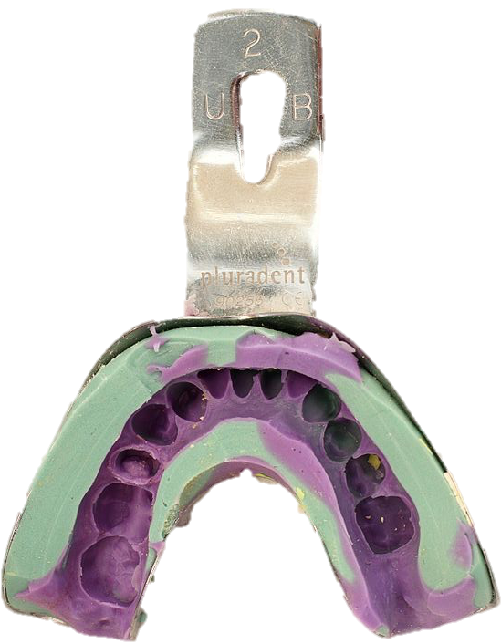
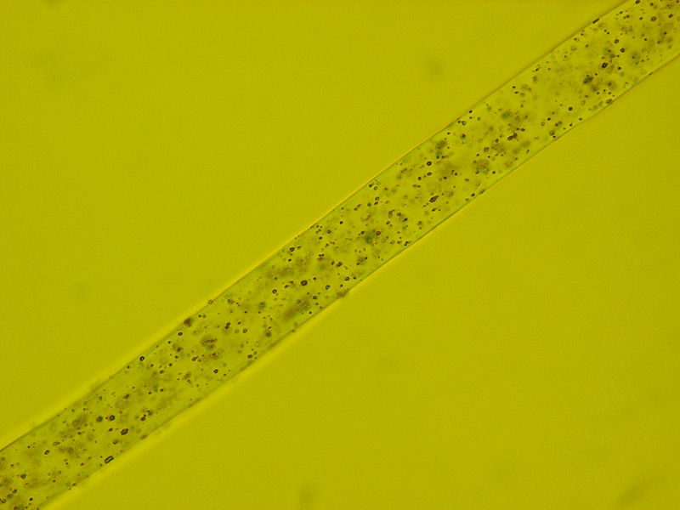
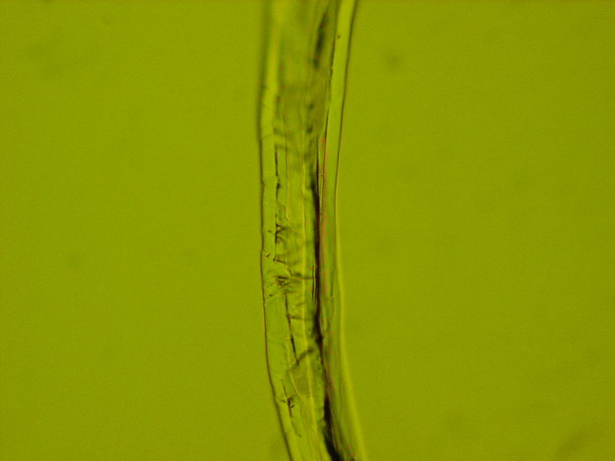
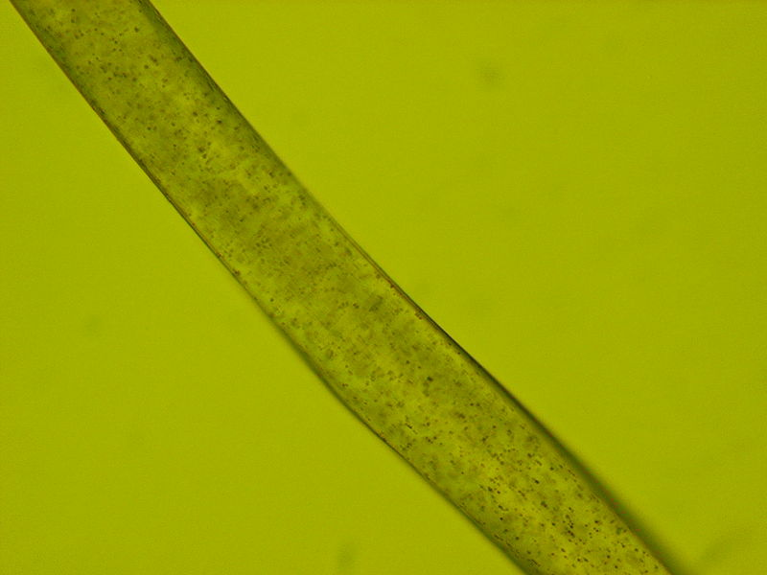
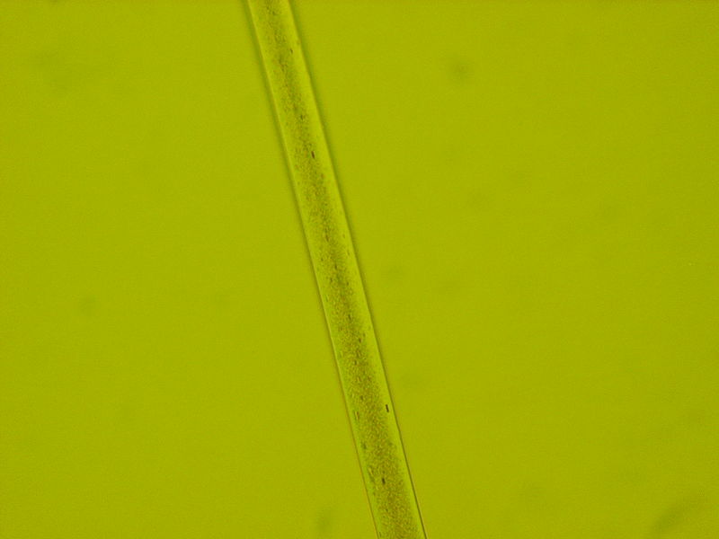
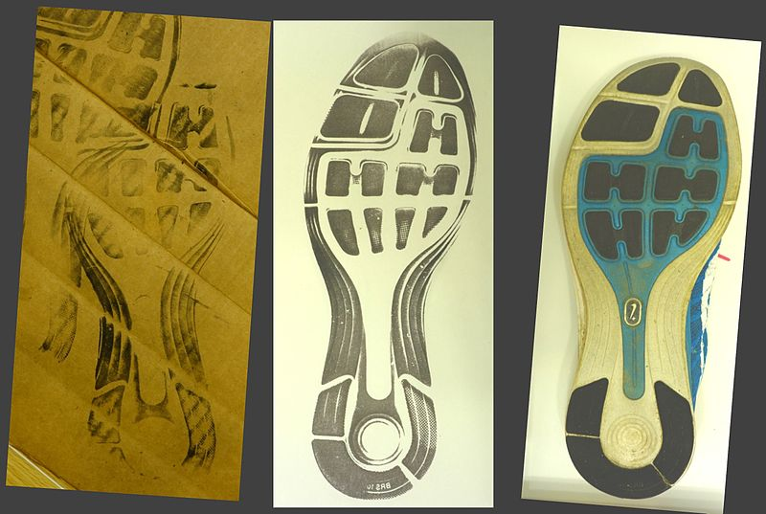
What types of things might be considered “evidence”?
Hair
Blood
Saliva
Fiber or fabrics
Fingerprints, footprints, lip-prints
Handwriting
Glass fragments
Teeth impressions
Dust, dirt or powders
Bin im Garten, WikiCommons.
Zalman992, WikiCommons.

Slide 6
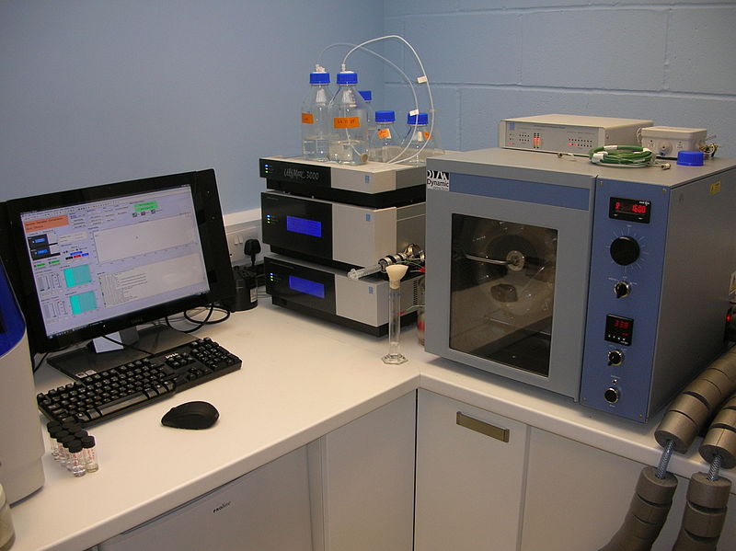
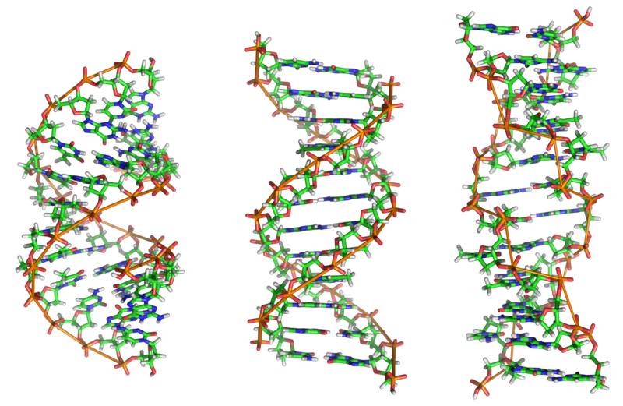
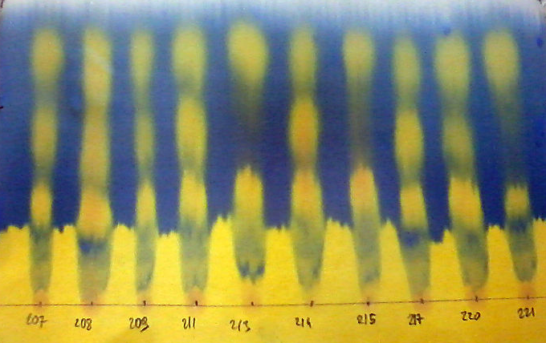
How might a forensic scientist analyze the evidence?
pH tests
Blood typing
Chromatography
DNA analyses
Teeth impression analyses
Madmozza, WikiCommons.
Roumpf, WikiCommons.

Slide 7
The Case of the Missing Diamond-Maker

Slide 8

What We Know
Dr. Suzy Squeeze’s Diamond-Maker machine that turns coal into perfect diamonds in less than an hour was stolen from her lab at Rags-to-Riches, the company where she works.
The thief left behind a number of clues…
  …it is your job as the Forensic Scientist to find out WHO did it!

Slide 9





The Suspects
Dr. Edwin Evil – Scientist
Randy Raggman – Night duty security guard
Sandra Dee – High school student
Malcolm Meddlesome – Dr. Squeeze’s boyfriend
Maria Maestra – The director of Rags-to-Riches Labs

Slide 10

Dr. Evil
Dr. Evil works in the same lab as Dr. Squeeze.
They have a long-standing rivalry.
Dr. Evil has been avoiding Dr. Squeeze ever since she became a celebrity for inventing the Diamond-Maker.
As usual, he was working in the lab the night of the robbery.

Slide 11

Randy Raggman
Randy works as a night security guard at Rags-to-Riches Labs.
He was working the night of the robbery.
He checked in on the Diamond-Maker during his rounds where he stopped in the lab to snack on a powdered jelly donut.

Slide 12

Sandra Dee
Sandra Dee is a high school student volunteer in Dr. Suzy Squeeze’s lab.
She is a big fan of Dr. Squeeze and is often seen working in the evening.
No one saw her the day of the robbery, but she has her own key.
She says she had a date that night.

Slide 13

Malcolm Meddlesome
Malcolm is Dr. Suzy Squeeze’s boyfriend.
He works as a computer technician in the lab.
He carries keys to all lab rooms so that he can work on the computers when the scientists aren’t around.
He says he was playing basketball at the time of the robbery.

Slide 14

Maria Maestra
Maria is the director of Rags-to-Riches Labs.
She keeps a close eye on her staff and is quick to take credit for the company’s successes.
She is a good scientist and likes to be in the spotlight.
She says she was at the movies during the robbery.

Slide 15
The Evidence
The following things were left behind at the scene of the crime:
Fingerprints
Spilled powder
Lingering perfumes
Clothing fibers
Spilled liquid
Pen markings

Slide 16
Solving the Mystery
Let’s examine the evidence from each station…

Slide 17
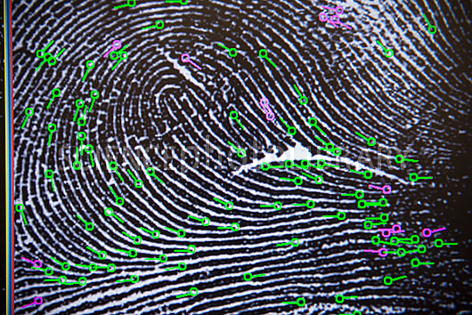
Fingerprinting
Fingerprint #1 belongs to: | Dr. Suzy Squeeze
Fingerprint #2 belongs to: | Malcolm
Fingerprint #3 belongs to: | Dr. Evil
How can we explain these findings?

Slide 18
Chromatography
Pen A belongs to: | Dr. Evil
Pen B belongs to: | Sandra
Pen C belongs to: | Malcolm
Pen D belongs to: | Randy
Whose pen was used to write the note?
Malcolm
How important do you think this piece of evidence is? Why?

Slide 19
Fiber Analysis
 | Fiber Color(s) and Pattern(s)
Maria
Randy
Sandra
Malcolm
Dr. Evil
Dr. Suzy Squeeze
Evidence #1 | Dr. Evil
Evidence #2 | Dr. Suzy Squeeze
Anything surprising about these findings?

Slide 20
Smells
What we know:
Paper towel found in the trash had strong smell
Perfume/cologne samples were collected from Sandra, Dr. Evil, Randy, & Malcolm
Evidence smell belongs to:
Sandra
Did you find a possible explanation for this particular finding?

Slide 21
Spilled Liquid
Dr. Evil | Alka Seltzer
Malcolm | Gatorade
Maria | Water
Sandra | Orange Juice
Whose drink was found at the crime scene?
Malcolm
Did you find a possible explanation for this particular finding?

Slide 22
Spilled Powder
 | Appearance Under Magnification | Texture | Reaction to Water | Reaction to Vinegar
Evidence | White fine powder | Silky, sticks to fingers | None, dissolves | None, dissolves
Powdered Sugar
Baking Soda
Baking Powder
What is the mystery powder?
Powdered Sugar
Who do you think spilled the powder in the lab? Randy
Why do you think so?

Slide 23
Summary of All the Evidence Found
Suspect | Finger- print | Chroma-tography | Fibers | Smells | Drink | Powder
Malcolm | X | X |  |  | X
Randy |  |  |  |  |  | X
Sandra Dee |  |  |  |  | X
Dr. Evil | X |  |  | X
Maria
Dr. Suzy Squeeze | X |  |  | X

Slide 24
Who Stole the Diamond-Maker?
Malcolm was hoping to impress his girlfriend, Dr. Suzy Squeeze, by making her a diamond ring.
After basketball practice, he snuck into the lab and “borrowed” the machine with the intention of returning it later that night.
Unfortunately, it was discovered missing by Randy before he could return it.
In the process he spilled his drink and left his prints on the glass cabinet.

